Slide 1
Chapter 1
Introduction

Slide 2
1-1 DATA COMMUNICATIONS
The term telecommunication means communication at a distance. The word data refers to information presented in whatever form is agreed upon by the parties creating and using the data. Data communications are the exchange of data between two devices via some form of transmission medium such as a wire cable.
Topics discussed in this section:
Components
Data Representation Data Flow

Slide 3
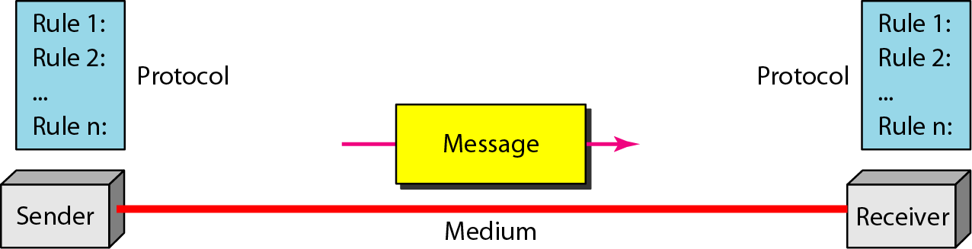
Figure 1.1 Five components of data communication

Slide 4
Data Communication: The effectiveness of a data communication system depends on three fundamental characteristics
Delivery: The system must deliver data to the correct destination.
Accuracy: The system must deliver data correctly.
Timeliness: The system must deliver data in a timely manner.

Slide 5
Networks: is a set of devices (often referred to as nodes) connected by media links.

Slide 6
Performance: can be measured in many ways, including transit time and response time.
Performance depends on:
Number of users
Type of transmission medium
Hardware
Software

Slide 7
Reliability of network includes accuracy of delivery.
Reliability of network is measured by:
Frequency of failure
Recovery time of a network after failure
Catastrophe

Slide 8
Network security issues include protecting data from:
Unauthorized access
viruses

Slide 9
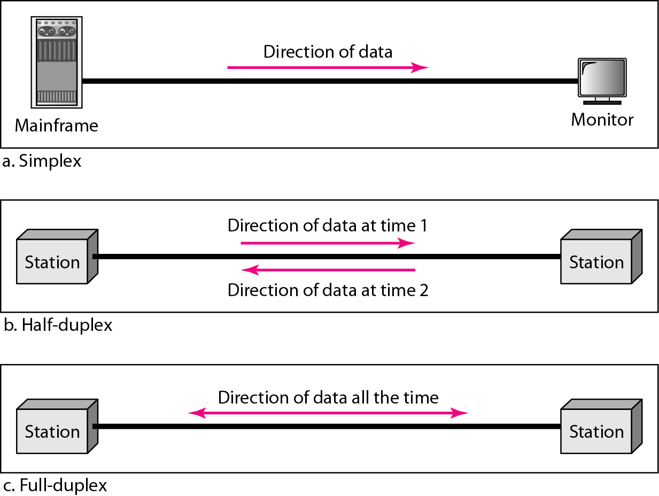
Figure 1.2 Data flow (simplex, half-duplex, and full-duplex)

Slide 10
1-2 NETWORKS
A network is a set of devices (often referred to as nodes) connected by communication links. A node can be a computer, printer, or any other device capable of sending and/or receiving data generated by other nodes on the network.
Topics discussed in this section:
Distributed Processing
Network Criteria Physical Structures Network Models Categories of Networks Interconnection of Networks: Internetwork

Slide 11
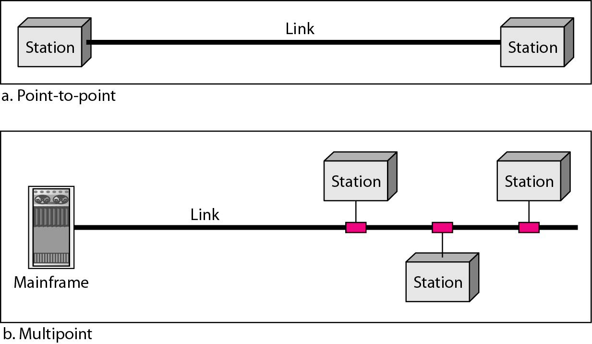
Figure 1.3 Types of connections: point-to-point and multipoint

Slide 12
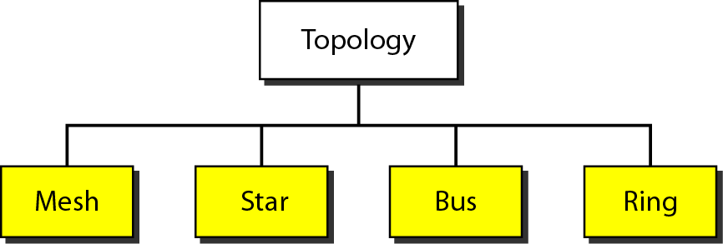
Figure 1.4 Categories of topology

Slide 13
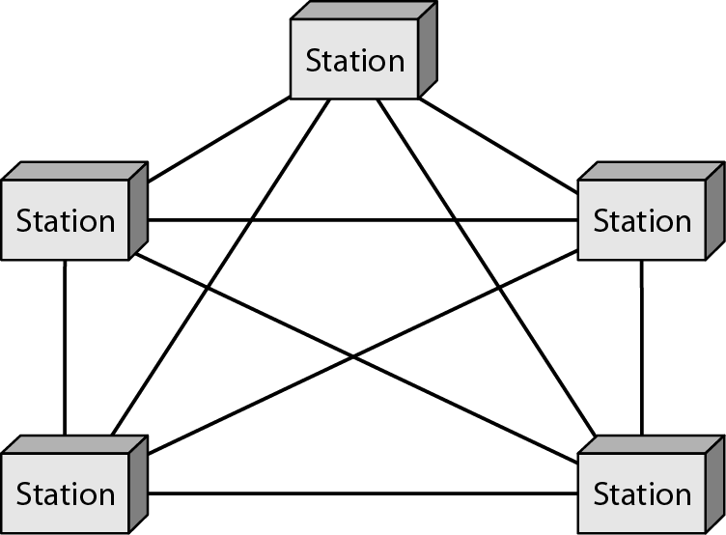
Figure 1.5 A fully connected mesh topology (five devices)

Slide 14
Advantages:
Use of dedicated links guarantees that each link carry its own data load.
Robust, if one link becomes unusable, it does not incapacitate the entire system.
Privacy or security, only intended recipient see the message traveling along the dedicated link.
Disadvantages:
Related to amount of cabling and and number of I/O ports required.
Installation and reconfiguration are difficult.
Hardware required is expensive.

Slide 15
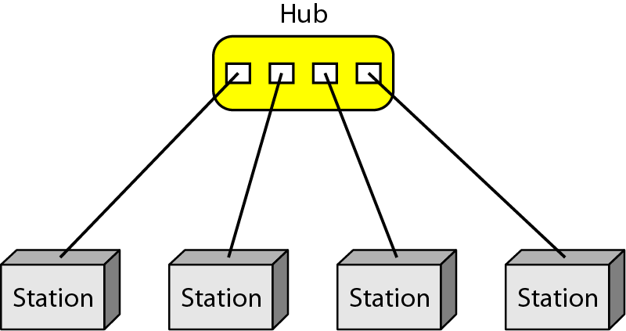
Figure 1.6 A star topology connecting four stations

Slide 16
Advantages:
Robust, if one link fails, only that link is affected
Easy fault identification and fault isolation.
Disadvantages:
Cabling amount

Slide 17
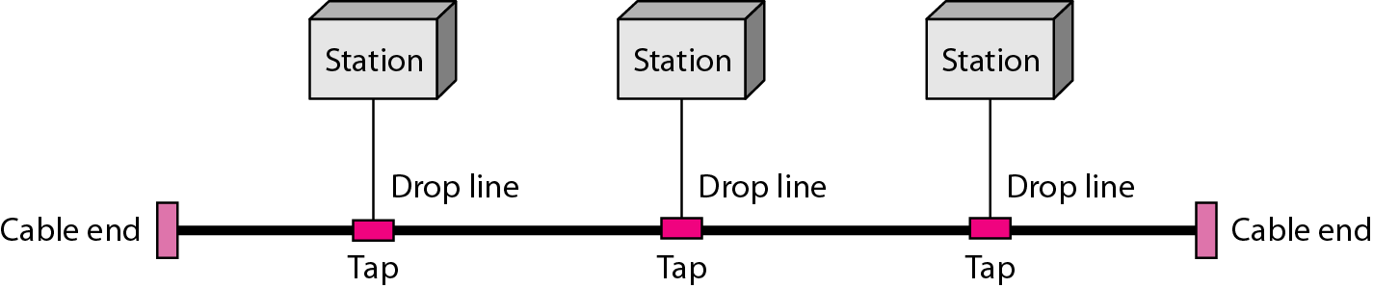
Figure 1.7 A bus topology connecting three stations

Slide 18
Advantages:
Installation is easy.
Disadvantages:
Reconfiguration and fault isolation are difficult.

Slide 19
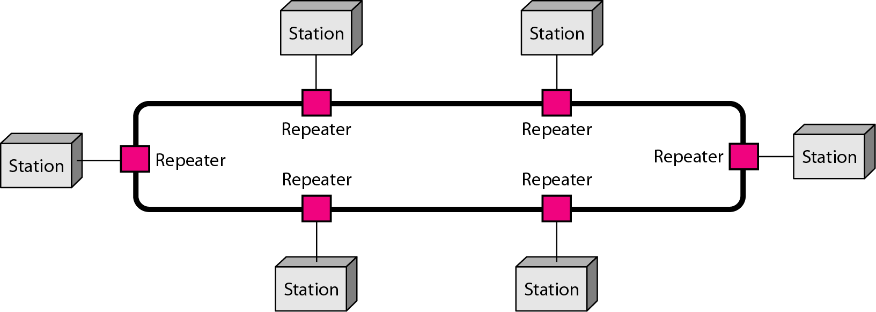
Figure 1.8 A ring topology connecting six stations

Slide 20
Advantages:
Installation and reconfiguration are easy.
fault isolation is simplified (alarm alert for signal lack)
Dual ring or switches are used to overcome ring break

Slide 21
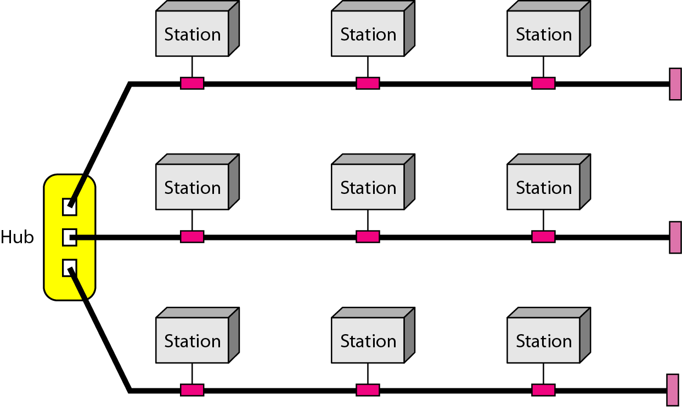
Figure 1.9 A hybrid topology: a star backbone with three bus networks

Slide 22
Hybrid Topology

Slide 24
Local Area Network

Slide 25
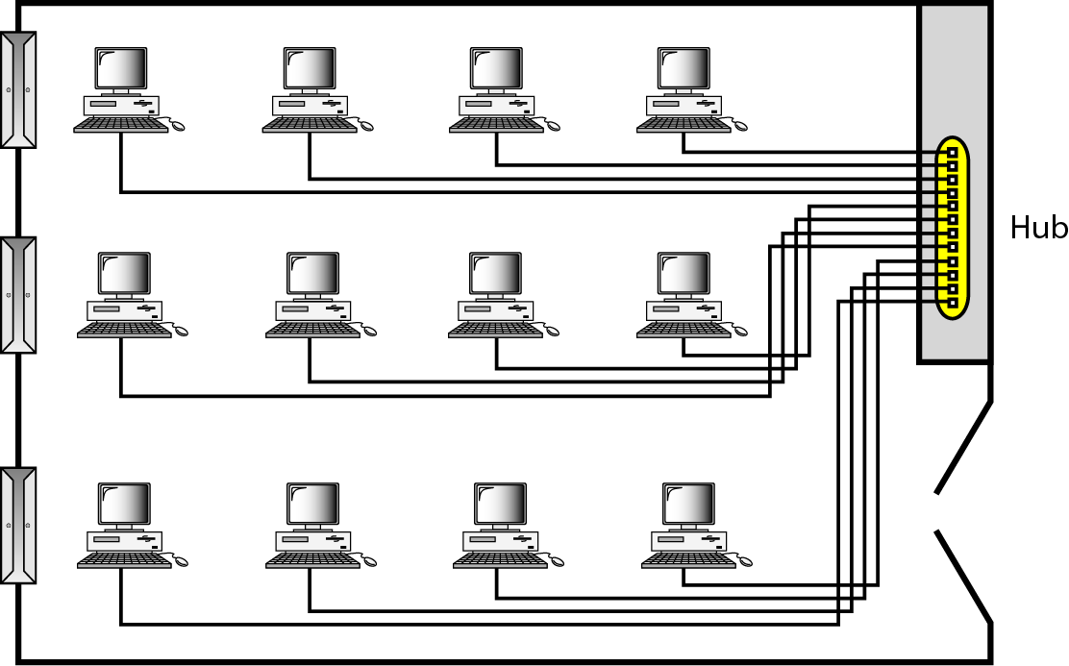
Figure 1.10 An isolated LAN connecting 12 computers to a hub in a closet

Slide 26
Local Area Network

Slide 27
Metropolitan Area Network

Slide 28
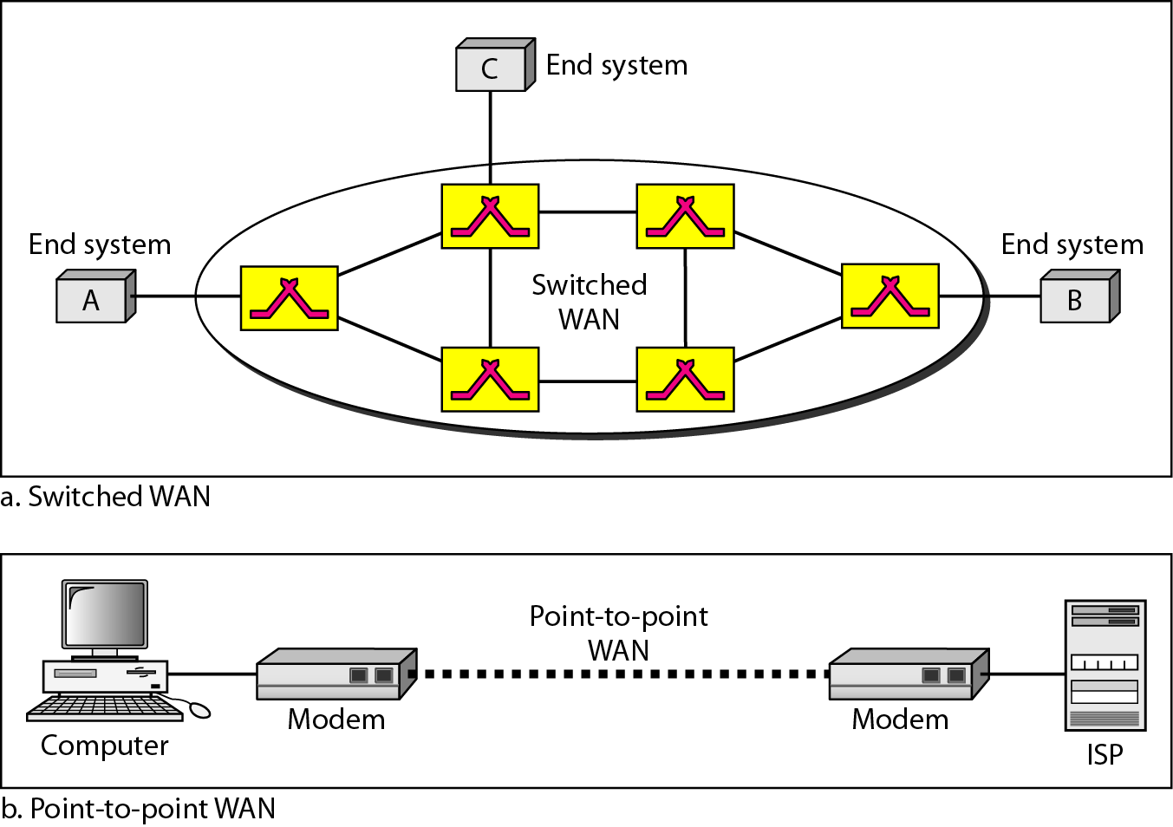
Figure 1.11 WANs: a switched WAN and a point-to-point WAN

Slide 29
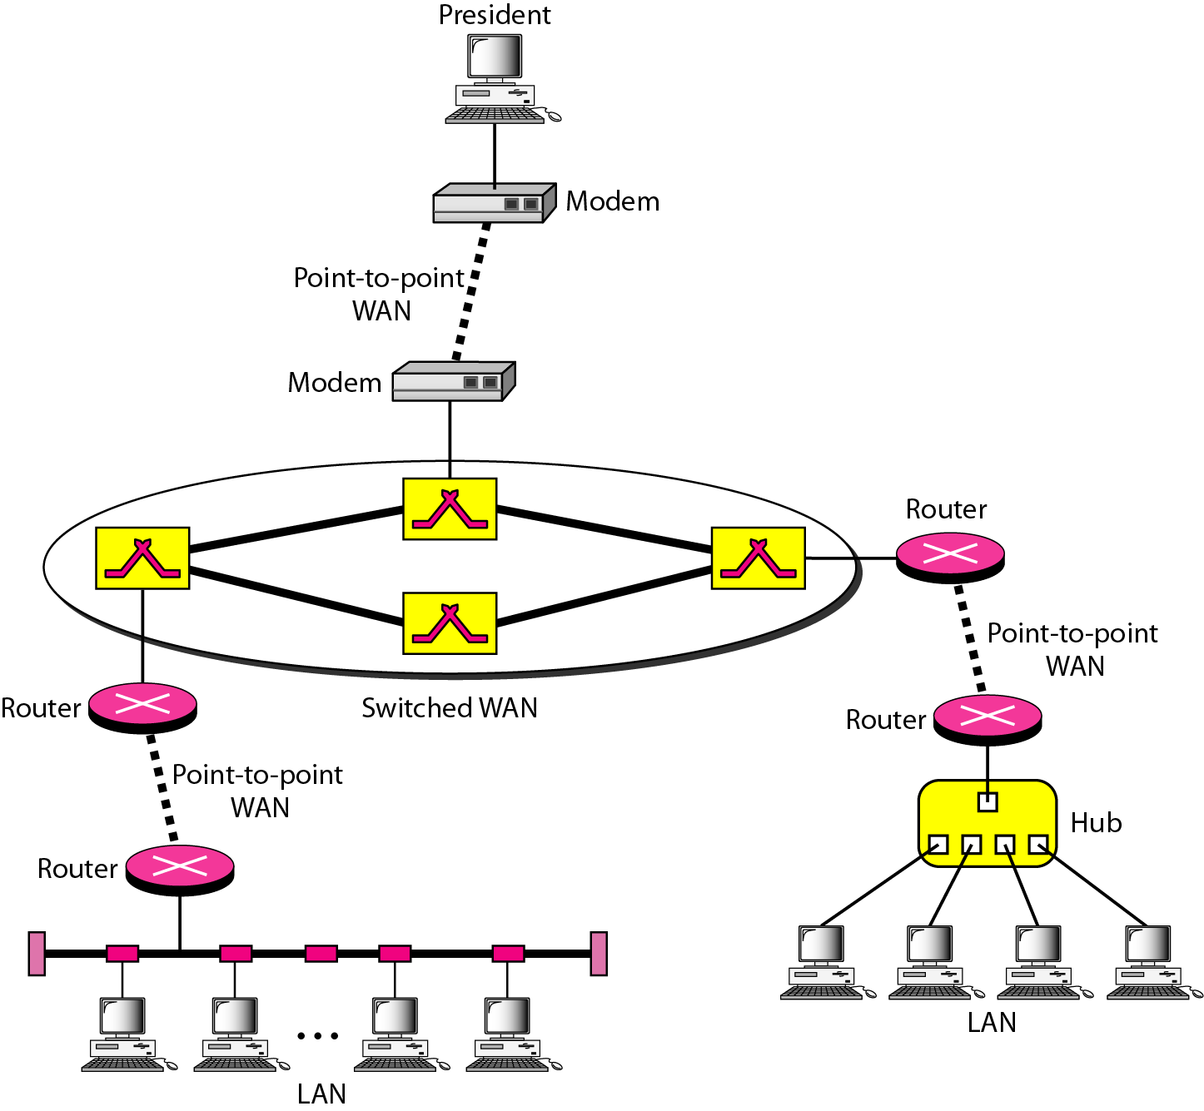
Figure 1.12 A heterogeneous network made of four WANs and two LANs

Slide 30
1-3 THE INTERNET
The Internet has revolutionized many aspects of our daily lives. It has affected the way we do business as well as the way we spend our leisure time. The Internet is a communication system that has brought a wealth of information to our fingertips and organized it for our use.
Topics discussed in this section:
A Brief History
The Internet Today (ISPs)

Slide 31
Internetwork
(Internet)

Slide 32
WAN/Internet

Slide 33
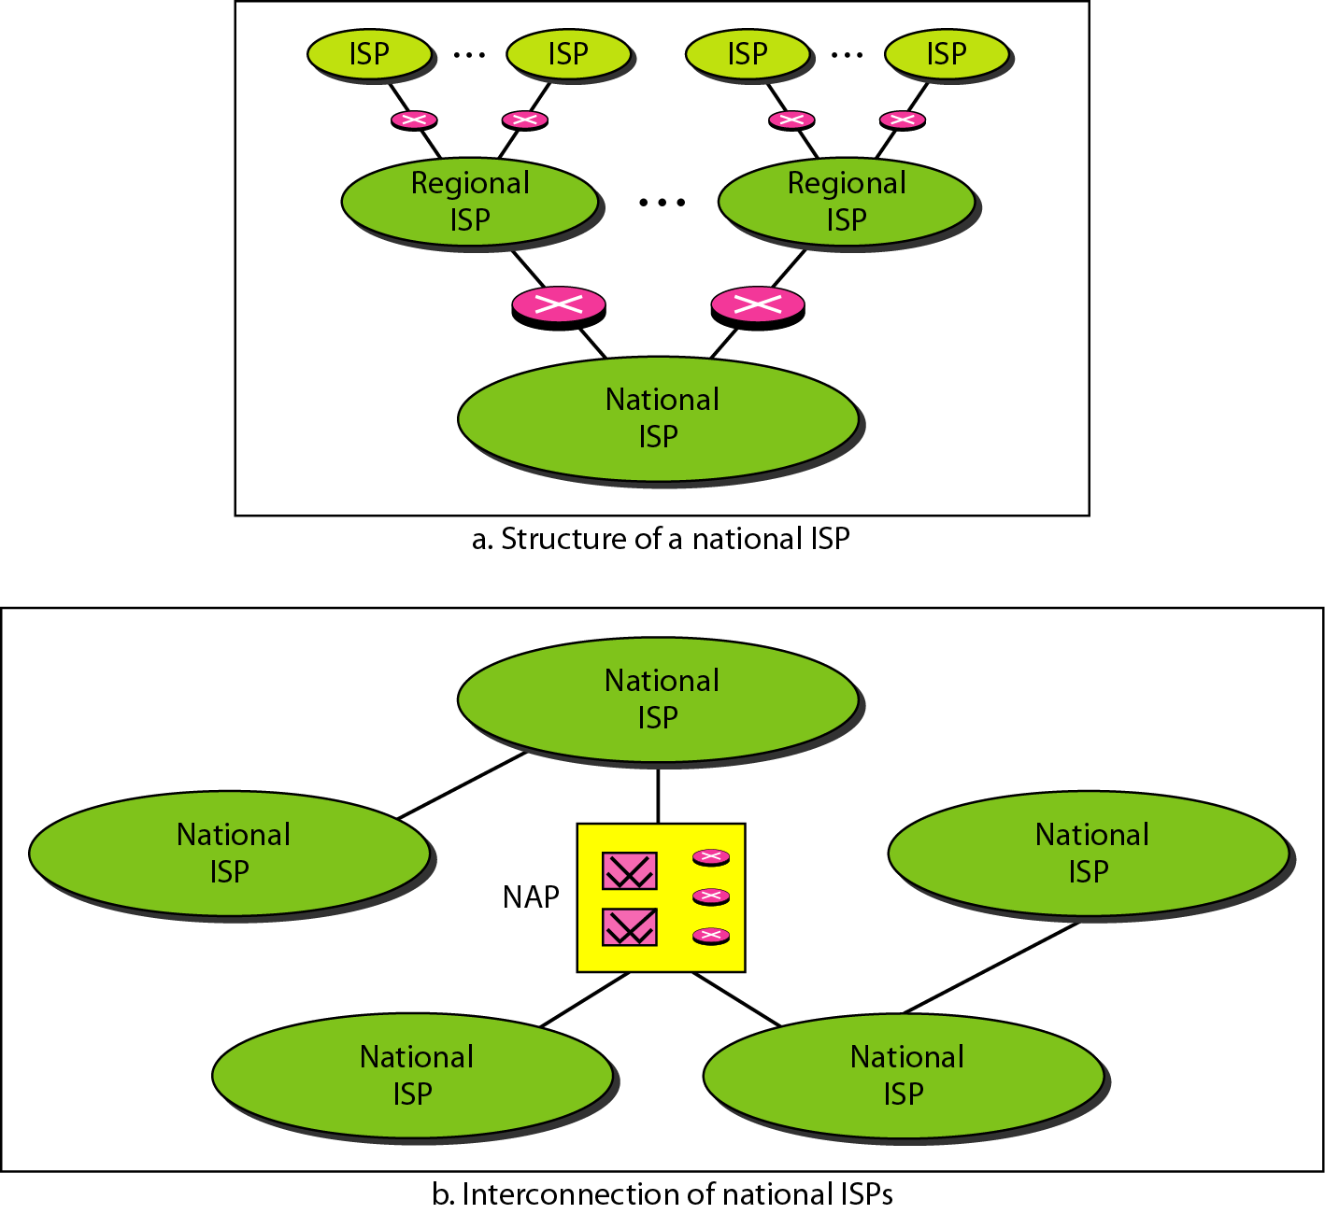
Figure 1.13 Hierarchical organization of the Internet

Slide 34
1-4 PROTOCOLS AND STANDARDS
In this section, we define two widely used terms: protocols and standards. First, we define protocol, which is synonymous with rule. Then we discuss standards, which are agreed-upon rules.
Topics discussed in this section:
Protocols Standards
Standards Organizations Internet Standards

